Slide 1
Single-Layer Perceptrons (PART 1)

Slide 2
Introduction
In early years of ANN research, pioneering contributions were
McCulloch and Pitts (1943) introduced the idea of NNs as computing machines
Hebb (1949) postulated the first rule for self-organized learning
Rosenblatt (1958) proposed the perceptron as the first model for learning with a teacher (Rosenblatt’s perceptron)
Perceptron is the simplest form of an ANN used for classifying linearly separable patterns
Linearly separable means things that lie on opposite sides of a hyperplane
It consists of a single neuron (therefore, can separate 2 classes)
The proof of convergence for the perceptron algorithm is known as perceptron convergence theorem
Extension to more than two classes (as long as they are linearly separable) is trivial by using multiple neurons in the output layer
The single neuron also forms the basis of an adaptive filter
Perceptron and adaptive filtering are naturally related to least-mean-square (LMS) algorithm

Slide 3
Chapter Organization
Linear Adaptive Filters and LMS algorithm
Adaptive Filtering Problem
Unconstrained Optimization Techniques
Method of Steepest Descent
Newton’s Method
Gauss-Newton Method
Linear Least Squares Filter
LMS Algorithm
Learning Curves
Learning-Rate Annealing Schedules (mostly omitted)
Rosenblatt’s Perceptron
Perceptron
Perceptron Convergence Theorem
Relation between Perceptron and Bayes Classifier for a Gaussian Environment (omitted)

Slide 4
Chapter Organization
Linear Adaptive Filters and LMS algorithm
Adaptive Filtering Problem
Unconstrained Optimization Techniques
Method of Steepest Descent
Newton’s Method
Gauss-Newton Method
Linear Least Squares Filter
LMS Algorithm
Learning Curves
Learning-Rate Annealing Schedules (mostly omitted)
Rosenblatt’s Perceptron
Perceptron
Perceptron Convergence Theorem
Relation between Perceptron and Bayes Classifier for a Gaussian Environment (omitted)

Slide 5
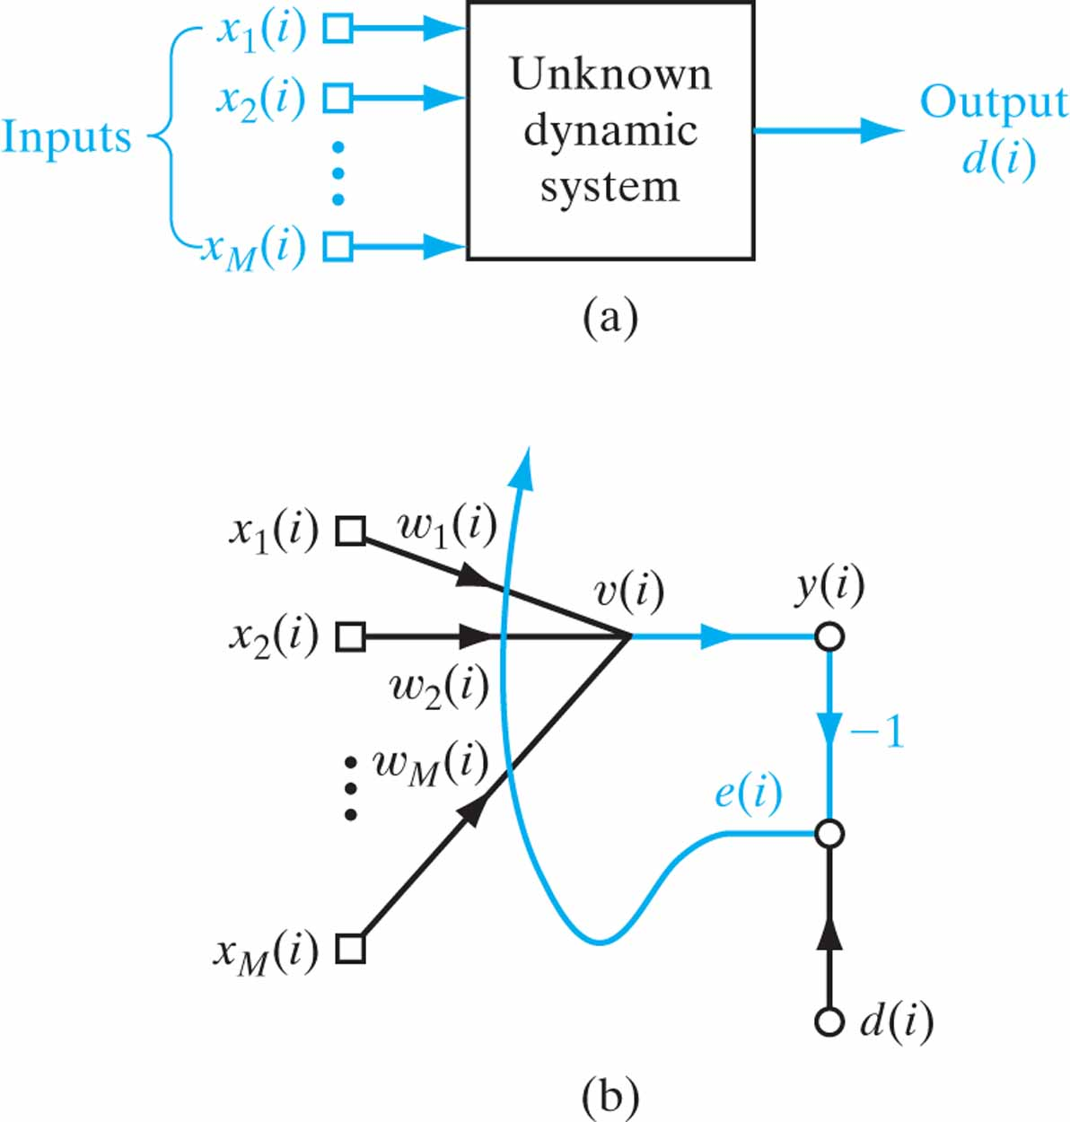
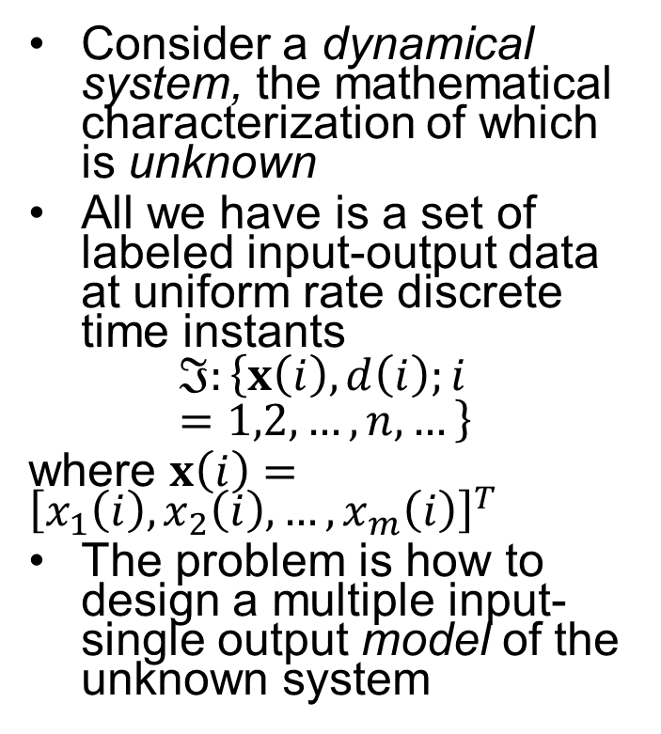
Adaptive Filtering Problem
Consider a dynamical system, the mathematical characterization of which is unknown
All we have is a set of labeled input-output data at uniform rate discrete time instants
$$ℑ:\left\{x\left(i\right),d\left(i\right);i=1,2,…,n,…\right\}$$
where $x\left(i\right)={\left[x_{1}\left(i\right),x_{2}\left(i\right),…,x_{m}\left(i\right)\right]}^{T}$
The problem is how to design a multiple input-single output model of the unknown system

Slide 6
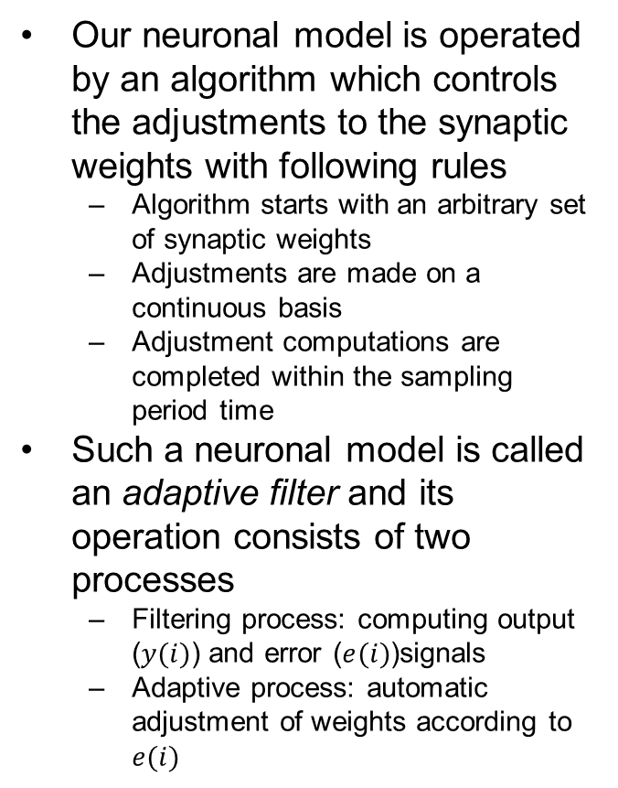
Adaptive Filtering Problem
Our neuronal model is operated by an algorithm which controls the adjustments to the synaptic weights with following rules
Algorithm starts with an arbitrary set of synaptic weights
Adjustments are made on a continuous basis
Adjustment computations are completed within the sampling period time
Such a neuronal model is called an adaptive filter and its operation consists of two processes
Filtering process: computing output ($y(i)$) and error ($e(i)$)signals
Adaptive process: automatic adjustment of weights according to $e(i)$

Slide 7
Chapter Organization
Linear Adaptive Filters and LMS algorithm
Adaptive Filtering Problem
Unconstrained Optimization Techniques
Method of Steepest Descent
Newton’s Method
Gauss-Newton Method
Linear Least Squares Filter
LMS Algorithm
Learning Curves
Learning-Rate Annealing Schedules
Rosenblatt’s Perceptron
Perceptron
Perceptron Convergence Theorem
Relation between Perceptron and Bayes Classifier for a Gaussian Environment (omitted)

Slide 8
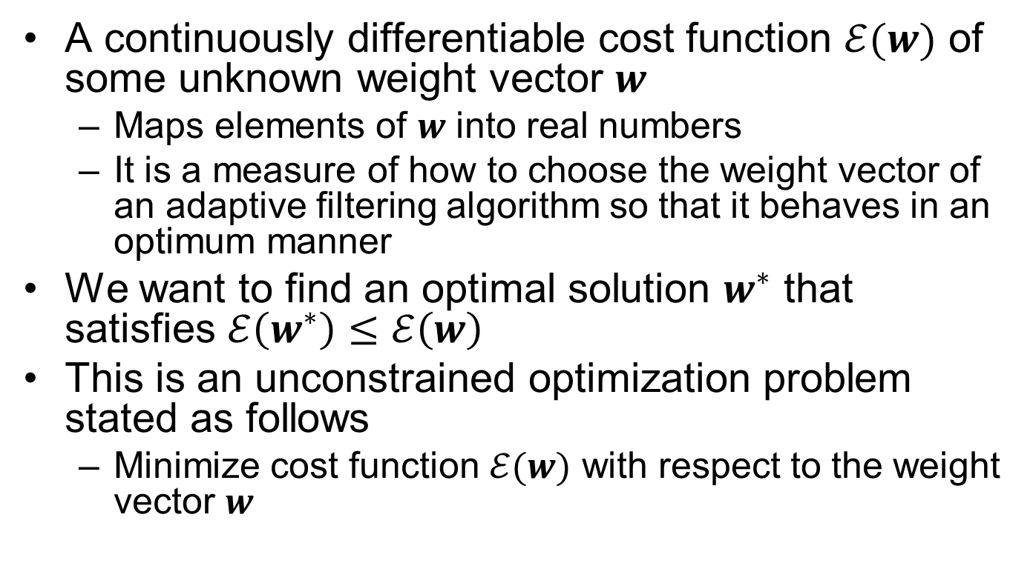
Unconstrained Optimization Techniques
A continuously differentiable cost function $ℰ(w)$ of some unknown weight vector $w$
Maps elements of $w$ into real numbers
It is a measure of how to choose the weight vector of an adaptive filtering algorithm so that it behaves in an optimum manner
We want to find an optimal solution $w^{∗}$ that satisfies $ℰ\left(w^{∗}\right)≤ℰ\left(w\right)$
This is an unconstrained optimization problem stated as follows
Minimize cost function $ℰ(w)$ with respect to the weight vector $w$

Slide 9
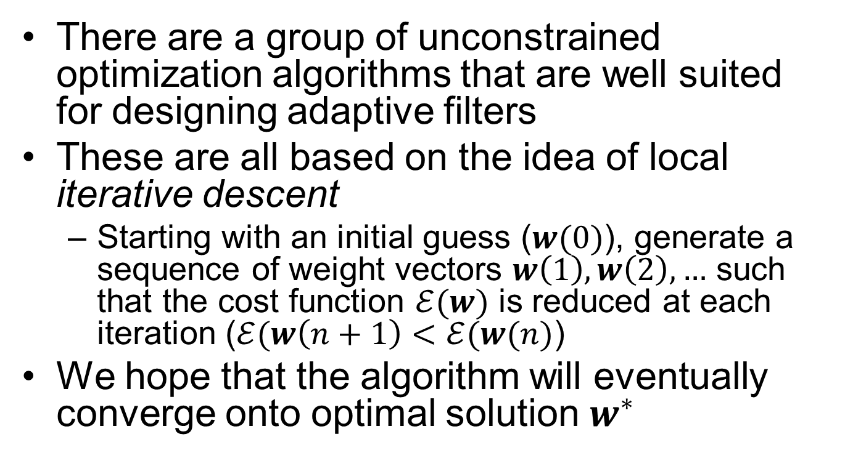
Unconstrained Optimization Techniques
There are a group of unconstrained optimization algorithms that are well suited for designing adaptive filters
These are all based on the idea of local iterative descent
Starting with an initial guess ($w(0)$), generate a sequence of weight vectors $w\left(1\right),w\left(2\right),…$ such that the cost function $ℰ(w)$ is reduced at each iteration ($ℰ(w\left(n+1\right)<ℰ(w(n)$)
We hope that the algorithm will eventually converge onto optimal solution $w^{∗}$

Slide 10
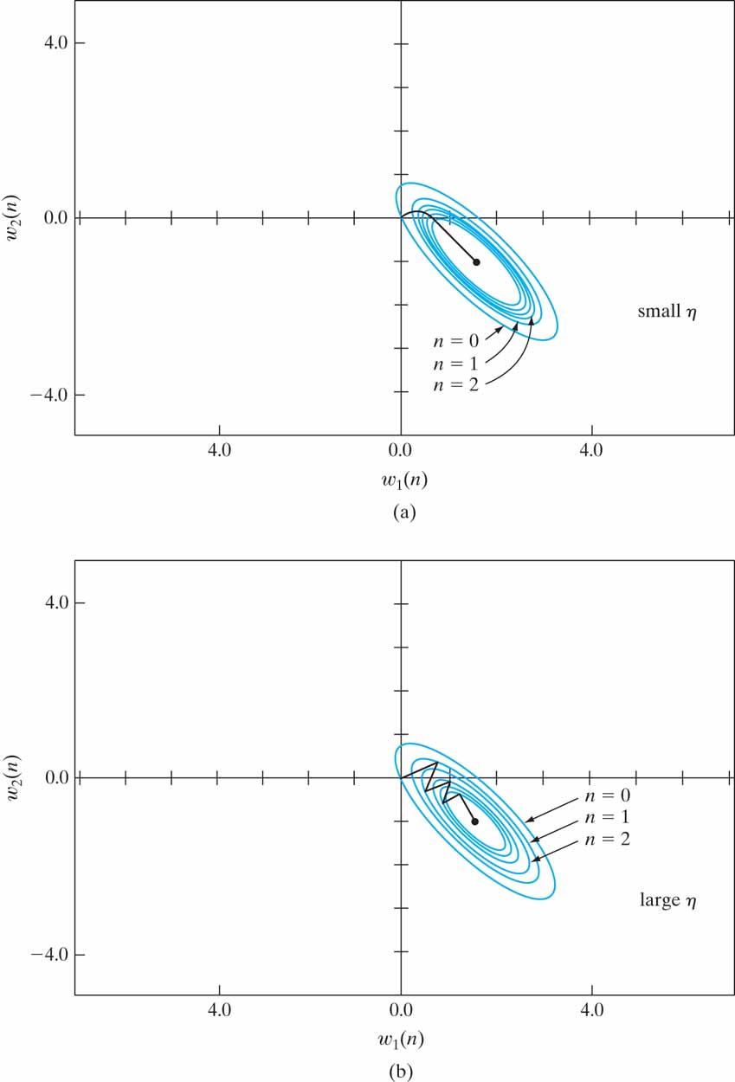
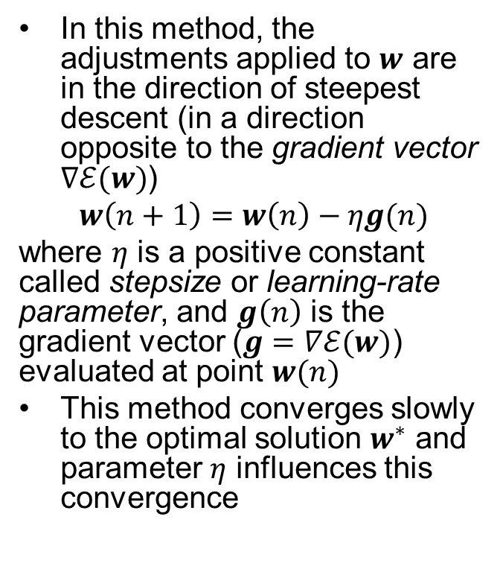
Method of Steepest Descent
In this method, the adjustments applied to $w$ are in the direction of steepest descent (in a direction opposite to the gradient vector $∇ℰ(w)$)
$$w\left(n+1\right)=w\left(n\right)−ηg(n)$$
where $η$ is a positive constant called stepsize or learning-rate parameter, and $g\left(n\right)$ is the gradient vector ($g=∇ℰ(w)$) evaluated at point $w(n)$
This method converges slowly to the optimal solution $w^{∗}$ and parameter $η$ influences this convergence

Slide 11
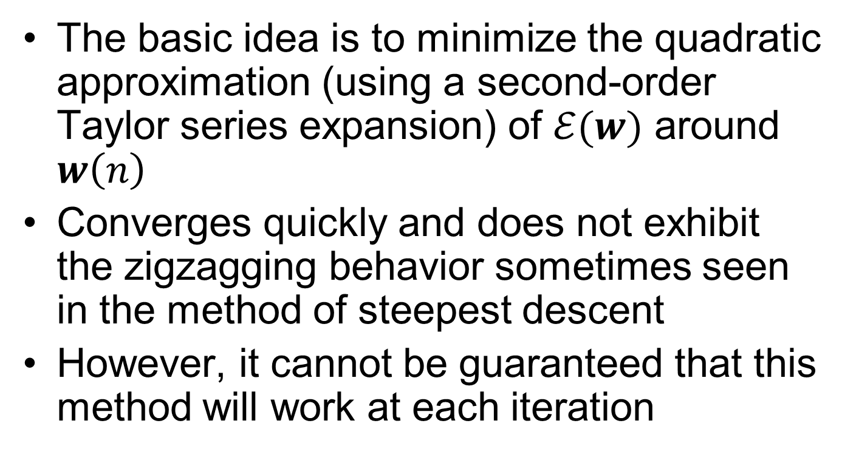
Newton’s Method
The basic idea is to minimize the quadratic approximation (using a second-order Taylor series expansion) of $ℰ(w)$ around $w\left(n\right)$
Converges quickly and does not exhibit the zigzagging behavior sometimes seen in the method of steepest descent
However, it cannot be guaranteed that this method will work at each iteration

Slide 12
Gauss-Newton Method
Applicable to a cost function that is expressed as the sum of error squares
This method does not require us to know about Hessian matrix which was important in Newton’s method. It only requires the Jacobian matrix.
But again, in its pure form, it is not guaranteed that it can be used at every iteration
However, it is applicable with a slight modification

